Slide 1
AAR Open Top Loading Rules
Scott vangosen sr manager load and ride solutions--open top loads
May 20, 2025

Slide 2
AAR Open Top Loading Rules Manual
Section 1 Inspection & Compliance
General Rule 1.1.1 These rules provide the requirements for loading and securing cargo on open top railcars for safe movement over North American Railroads
General Rule 1.1.5 These rules are considered to be minimum requirements. Any deviation that results in a reduction of these requirements will be considered a loading rule violation. Additional packaging material and/or securement may be added at the discretion of the shipper or consignee’s requirements provided the additional dunnage does not compromise load securement or contribute to unsafe operations
Notes:
Explain that the purpose of the Open Top Rules is to provide safe movement of car and commodity from point of origin to destination by using uniform and economical methods of securement, and they are mandatory.

Slide 3
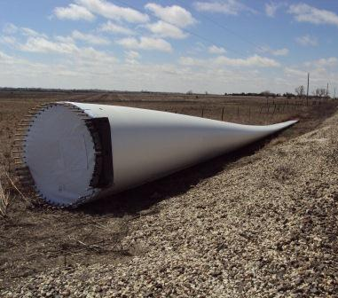
AAR Open Top Loading Rules Manual
Section 1 Responsibility and General Requirements
Who is responsible for loading and securing lading on rail cars?
1.2.1 Shipper is responsible for properly loading and securing lading for safe transport to destination… Carrier’s acceptance of the load or lack of origin inspection does not negate shipper’s responsibility.
1.2.2 Shippers must adhere to drawings and specifications of an applicable figure where available, as well as applicable General Rules…
  What can happen as a result of improperly loaded rail cars?

Slide 4
AAR Open Top Loading Rules Manual
Section 1 Responsibility and General Requirements
1.2.4.1 Any party performing a load adjustment or transfer is responsible for ensuring the shipment is properly and safely loaded/secured according to the AAR Open Top Loading Rules.
1.2.4.2 Parties addressing load securement will not be held accountable for concealed securement items within the load that are not accessible for inspection at time of adjustment.
1.2.5 Carrier’s reserve the right to refuse loads loaded in compliance with these rules if safety issues develop relative to the Figure or materials used.
1.2.6 When a specific figure is not available, loads are to be prepared in accordance with all General Rules in this Section. Origin carrier, may provide a modification of a figure designated as a special authority load.

Slide 5
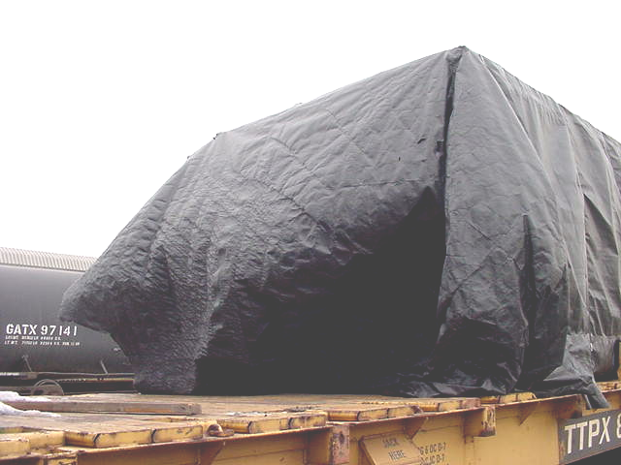
AAR Open Top Loading Rules Manual
Section 1 Special Equipped Status
1.2.25 Unless otherwise specified, other material may not be applied between the commodity and the bearing points without Committee approval.
1.2.26 Any protective covering, must be adequately secured to prevent it from working loose…
Notes:
Taprs/covering must not become an operational hazard resulting from dragging or catching on something during transit.

Slide 6
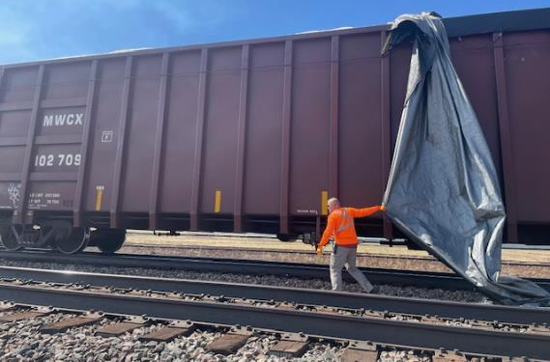
AAR Open Top Loading Rules Manual
Section 1 Special Equipped Status
General Rule 1.2.27 When tarpaulins or other types of coverings are used, the coverings must be of adequate construction to resist tearing or other forms of degradation brought about by such things as, but not limited to, wind, vibration, movement, and abrasion

Slide 7
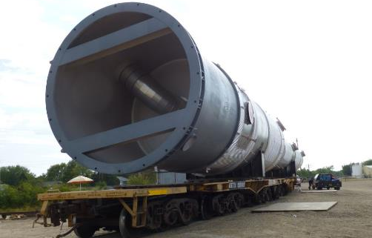
AAR Open Top Loading Rules Manual
Section 1 Special Authority and General Rule Loads
1.3.1 Special authority must be obtained by the shipper from the originating carrier for shipments of any commodity on open top cars not covered by a specific figure is Sections 2 through 6.
1.3.3 Unless an approved figure is used, consistent loading of a commodity on a car places an obligation on the shipper to promptly request approval of a specific figure to cover the desired load design.
Notes:
Consistent loading is 25 or more shipments secured in the same manner

Slide 8
AAR Open Top Loading Rules Manual
Section 1 Weight Distribution and Load Location on Single Cars
3.2 Unless otherwise allowed in specific figure, all load weights must be equally distributed end-to-end and side-to-side at origin. If ballast is needed to equalize weight distribution, refer to Rule 3.4.2
3.4.1.1 Weight of load on car must not exceed the load limit stenciled on the car. Weight of load on one truck must not exceed ½ of the load limit stenciled on the car

Slide 9
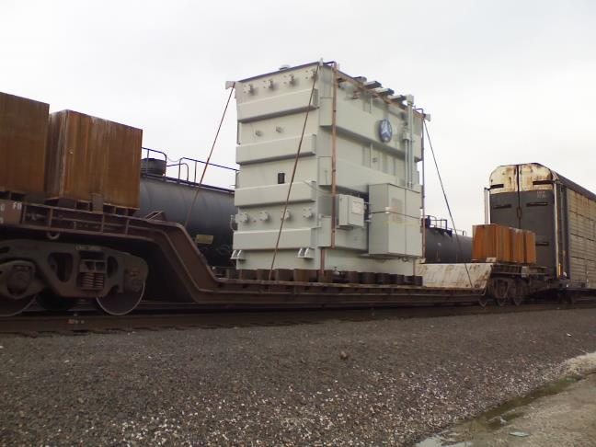
AAR Open Top Loading Rules Manual
Section 1 Weight Distribution and Load Location on Single Cars
3.4.2.1 Counterweight/Ballast must be secured per General Rule 5. The weight of the counterweight and its securement must be included as part of the total load weight and meet proper load distribution requirements. Structural integrity of counterweights must be sufficient to withstand securement to the car and rail forces.

Slide 10
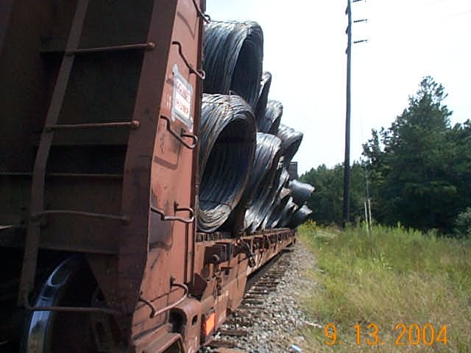
AAR Open Top Loading Rules Manual
Section 1 Securement
3.4.3.1 Regardless of vacant space across a car, the load must be secured to prevent any portion of the load from shifting, resulting in a potential off-balance condition and/or displacement of the load from the car.

Slide 11
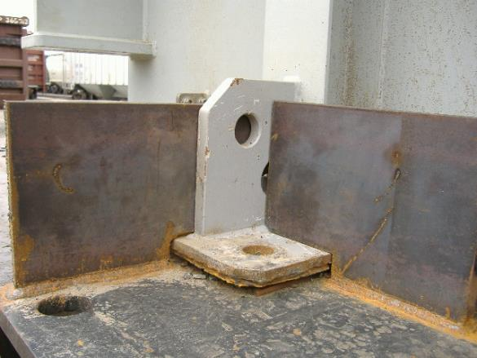
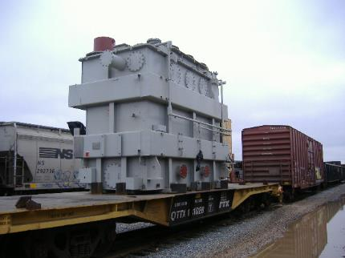
Transformers
How are they secured?
What is used for vertical securement?

Slide 12
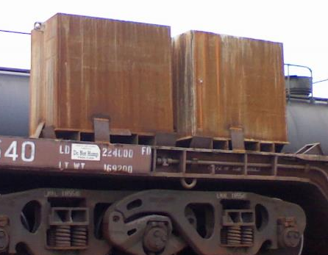
Ballast / Counterweight
How is it secured?
Notes:
Discuss General Rule 14.13.6 Welding lading directly to a car is prohibited
14.13.9 Welding of rods, flat bar, & straps directly to both the load and car for the purpose of securing the load is prohibited unless otherwise provided for in a specific figure
14.13.10 One end of the aforementioned items may be welded to either the load or car and the opposite end secured in an approved manner

Slide 13
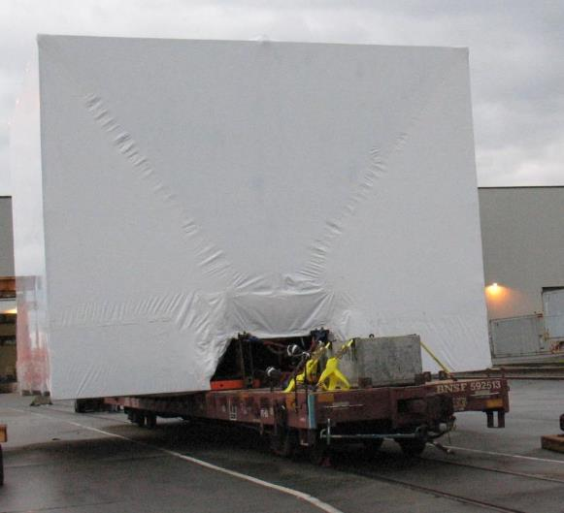
What is a dimensional load?
Per AAR:
Any load that exceeds
10 ft. 8 in. wide
15 ft. 1 in. ATR
Any load that extends past the end sill or side sill of carrying car
Per BNSF:
Any load that exceeds
  11 ft. wide
  17 ft. ATR
Any load that extends past the end sill of car
Notes:
NOTE All High/Wide Loads must be measured and reported to Dimensional/Clearance Team on originating Railroad for approval prior to movement.

Slide 14
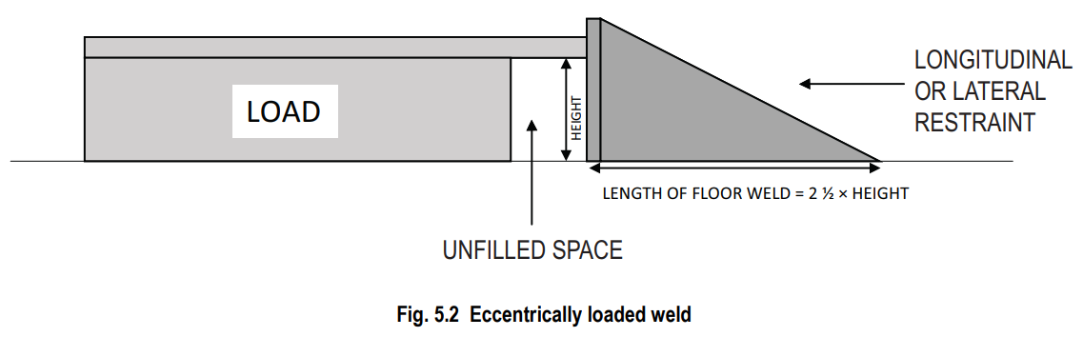
AAR Open Top Loading Rules Manual
Load Restraint
5.2 Load Restraint Application Any load in which the vertical point of contact is over 1 in. above rail car floor is considered an eccentrically loaded weld. See Appendix D, Table D.3.1
Notes:
Table D.3.1 Provides how many stops are required, and what length they are to be, based upon load weight, and vertical point of contact.

Slide 15
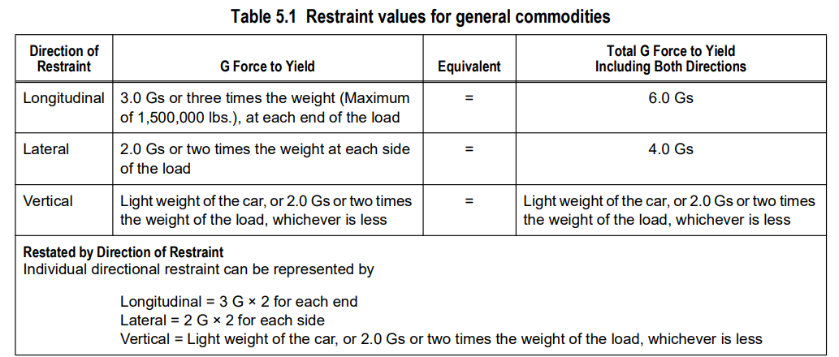
AAR Open Top Loading Rules Manual
Load Restraint Requirements
5.3.1 When a specific figure is not involved the load restraint values shown in Table 5.1 must be observed..

Slide 16
AAR Open Top Loading Rules Manual
5.7 Securement of Parts, Accessories, and Returnable Dunnage
5.7.1 All attached parts or accessories of a load and returnable dunnage must be adequately secured to prevent loosening, damage, or loss in transit.
5.7.2 Crated Material
5.7.2.1 Structural integrity of box, crate, or container must be sufficient to withstand securement to the car and to retain its contents while enduring shocks typical of the commercial rail environment.
If crates are to be stacked, bottom crates must be able to support the additional weight.

Slide 17
AAR Open Top Loading Rules Manual
Machines and other lading with moving parts
6.1.1 Machinery with rotating or swinging portions must have those components tied down to the car or machine to prevent rotation, swing-out, or displacement. Any locking devices that might be provided on the machine must be engaged.
6.1.2 Telescoping booms and outriggers must be fully retracted and locked.
6.2 Any objects subject to rotating or swinging and having protruding appurtenances that could swing beyond the car’s vertical plane or beyond the shipment’s clearance profile must be secured to prevent such movement.

Slide 18
AAR Open Top Loading Rules Manual
Attachment of Securement
14.1 Securement items must not be attached to or interfere with a car’s safety appliances, which include handholds, handrails, ladders, walkways, handbrakes or wheels, coupler operating levers, etc.
14.4 Any points of attachment must be at least as strong as the securement being attached.
14.8 It is prohibited to make holes in any structural member of the car, such as center, side, and end sills, corner posts, top chord angles, car side stakes, and other structural members of the car’s underframe, without explicit permission from the car owner, and then only to the extend permitted by the AAR Interchange Rules.
14.9 Making holes or slots in heavy duty flatcars may be done only with explicit permission from the car owner. For other cars, every effort must be made to avoid cutting unnecessary holes or slots and to confine them to the minimum number and dimensions required to secure the load.
Notes:
It is preferred that securement holes be drilled, not torch-cut to reduce chance of cracking and to prevent making holes larger than necessary.

Slide 19


AAR Open Top Loading Rules Manual
Welding of Securement
14.13.3 Welding of any load anchors and/or securement items must be performed by a welder certified in accordance with applicable AAR specification or with AWS D15.1.
14.13.1 The quality of welding performed is the responsibility of the organization and its contractors and they shall perform whatever tests are necessary to meet the requirements of American Welding Society (AWS) D15.1, Railroad Welding Specification for Cars and Locomotives.

Slide 20
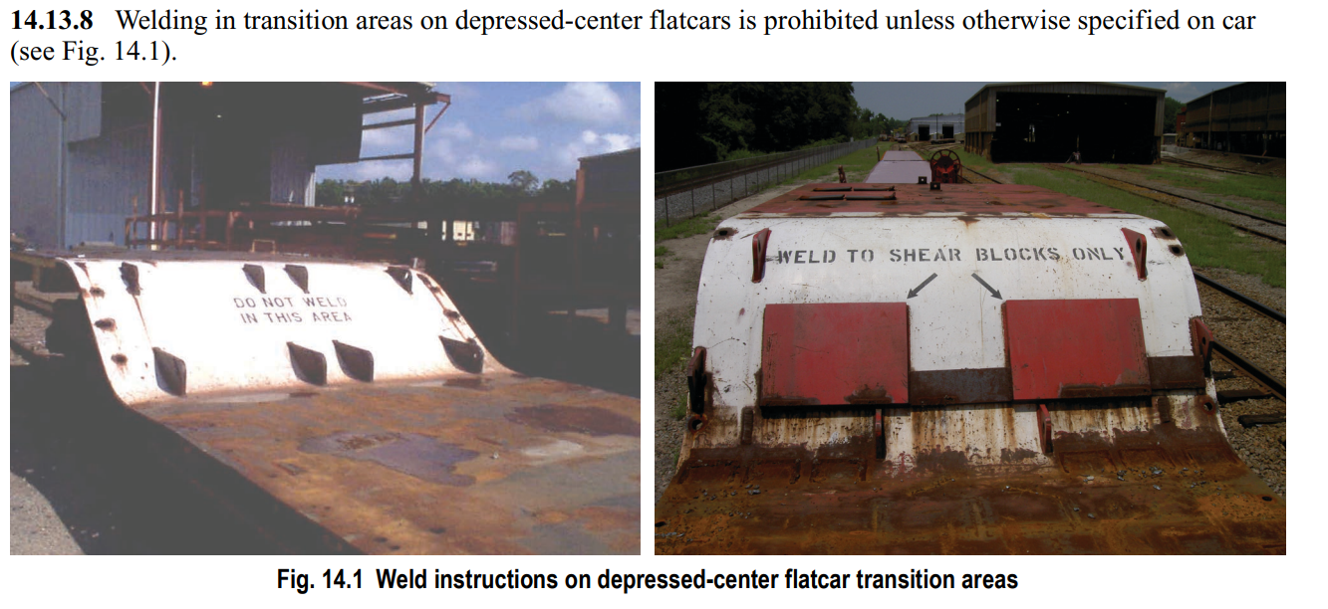
AAR Open Top Loading Rules Manual
Welding of Securement
When/where is welding not acceptable?
Notes:
14.13.6 Welding lading directly to a car is prohibited.
14.13.7 Welding to nailable steel flooring is prohibited.
14.13.9 Welding of such items as rods, flat bar, and straps directly to both the load and car for the purpose of securing the load is prohibited unless allowed in a Figure
14.13.10 One end can be welded to either the load or car and the opposite end secured in an approved manner.

Slide 21
AAR Open Top Loading Rules Manual
Idler Cars
28.1 Idler cars must be used when a load projects beyond the end sill of a carrying car, or cars, or when necessary to space two carrying cars.
28.2.1 Sufficient clearance must be provided when loading to maintain a 4 in. vertical clearance between load and any part of the idler car or dunnage…
Notes:
Discuss space on idler car/s can be used for loading with appropriate distance (2 ft. or 6 ft.) between load and load overhang on adjacent car/s.
Discuss disabling uncoupling levers to prevent unintentional separation of load/idler cars.

Slide 22
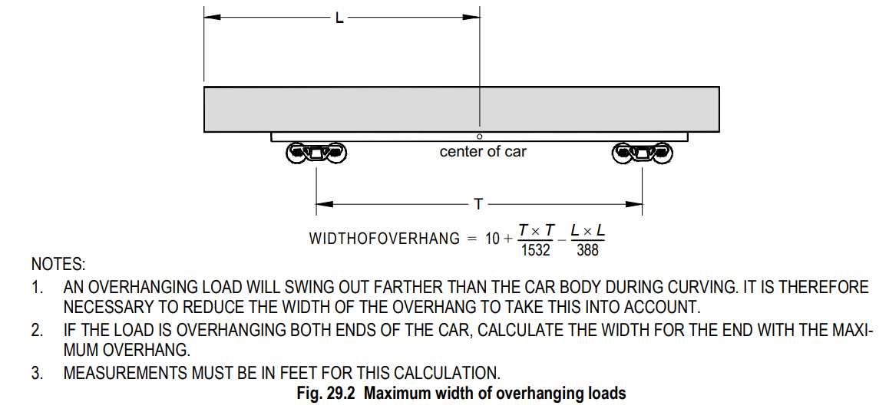
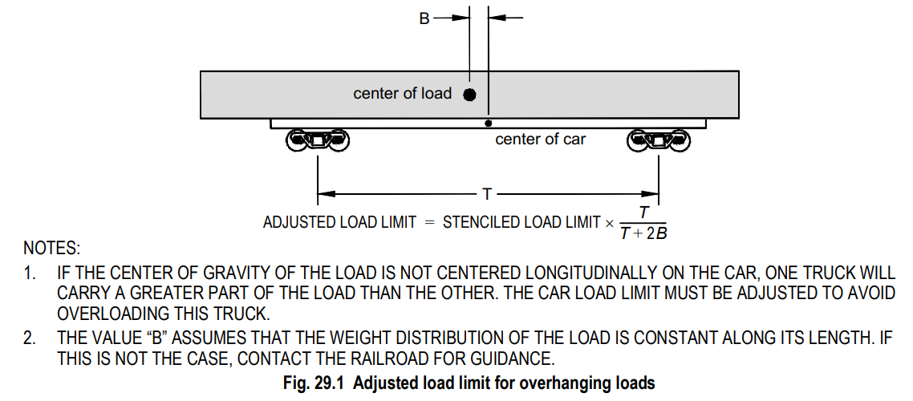
AAR Open Top Loading Rules Manual
Loads on one car overhanging one or both ends of car
29.2 Length of load or width of overhanging portion of load, as calculated in Figs. 29.1 and 29.2, must not be exceeded.

Slide 23
AAR Open Top Loading Rules Manual
Loads on two or more cars
30.1 Unless otherwise specified in a figure, loads long enough to be supported by more than one car require the use of pivoting bolsters that must be fabricated to support the load.
30.10.1 Pivoting Bolsters
  Vertical restraint between cargo and top plates must be 15% of the cargo weight with a min of 50,000 lbs.
  Lateral restraint between cargo and top plates must be 75% of cargo weight
  Longitudinal restraint (fixed bolster) Top plate to cargo must be 300% of cargo weight with a max of 1,500,000 lbs.
  Longitudinal restraint (sliding bolster) Top plate to cargo must be 50% of cargo weight
If the two bolstered cars are not coupled together, both bolsters must be designed as fixed bolsters and the min strength must be 300% of cargo and trailing railcar weight, with a max of 1,750,000 lbs. for each bolster
Notes:
Discuss Coupler Slack Blockout: when is it required and how to do it

Slide 24
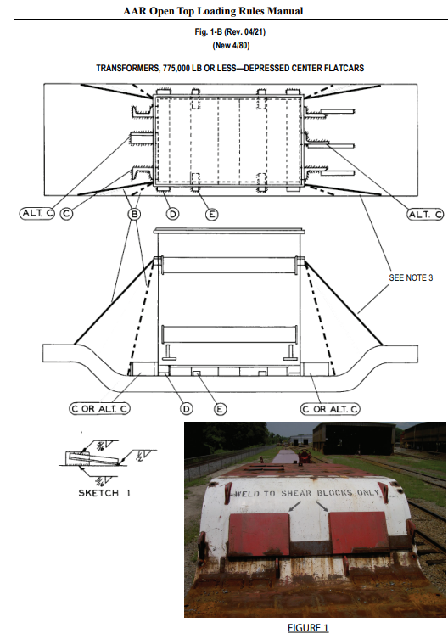
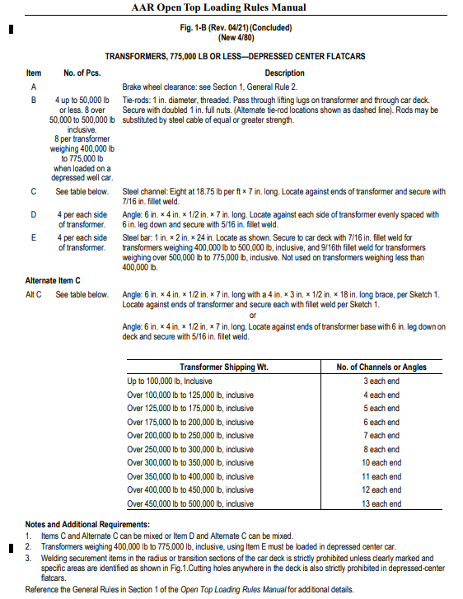

Slide 25
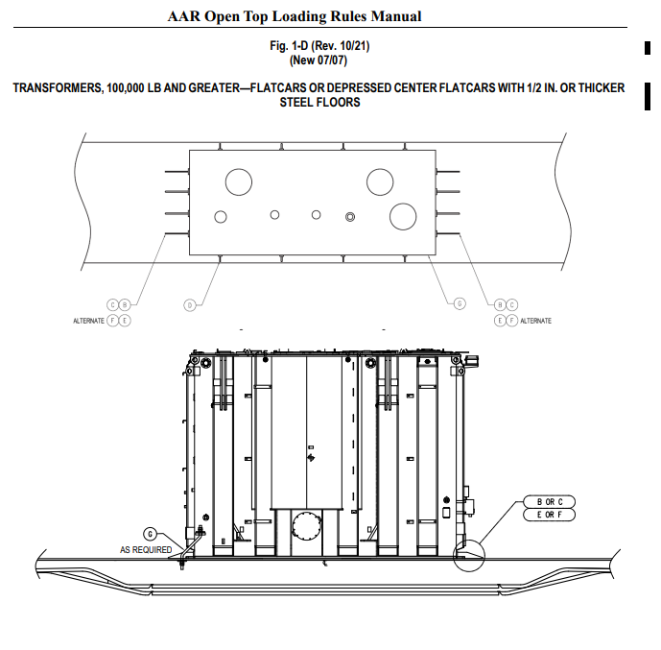

Slide 26
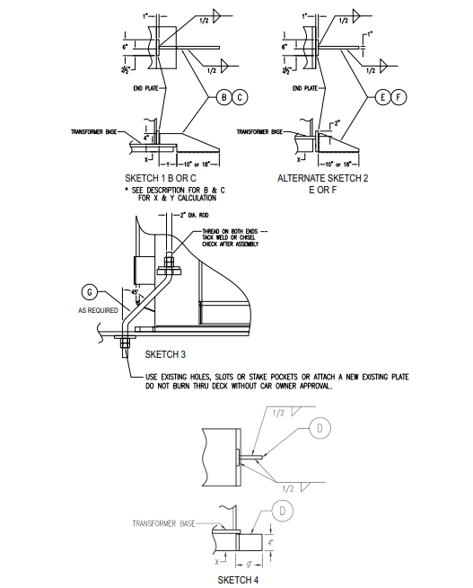
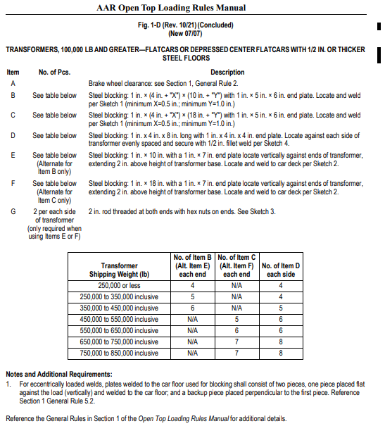

Slide 27
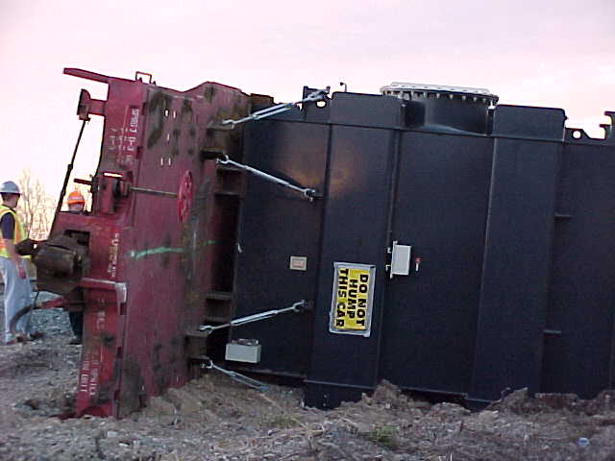
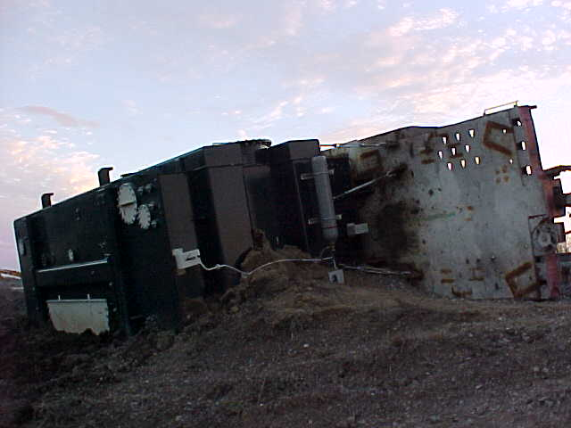
When things go wrong

